Slide 1
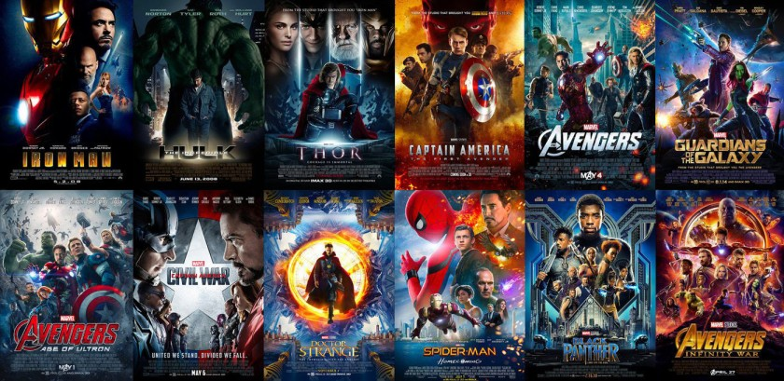
ABC Production Company:
Investment Optimization A14

Slide 2
Agenda
Content
Business Overview
Data Understanding and Preparation
Exploratory Data Analysis
Modelling
Possible Deployment

Slide 3
Goal: What kind of movies should ABC invest?
Business Overview
Ideas to proceed?
Identify movies that can potentially generate high revenue
Predict movies’ reputation: IMDB score
How does this help our investment?

Slide 4
Data Understanding: IMDB dataset
Data Understanding
30 columns (# of features)
1841 observations (# of movies in the data)
Target Variable
IMDB_score
Revenue
Features/Attribute
Genre
Runtime
…..

Slide 5
Final Dataset: ~2000 Movies and Relevant Info
Data Preparation
Dataset I
IMDB Dataset
Dropped Redundant Columns
Example: Tagline, Secondary_Genre, Third_Genre, Overview
Analysis Suitable Conversion
Example:
#ProductionCompanies, #ProductionCountries, Revenue & Budget in Millions
Missing Value Treatment
Example: Dropping records with 0 runtime OR missing budget and revenue
Final Movie Data
(released post Yr 2000)
Dataset II
Cast Information
Movie Details: Name, Cast, Cast FB likes, Release Date,Production Company, Production Country etc.
Movie Performance: Revenue, IMDB score, Vote count, Avg. Vote

Slide 6
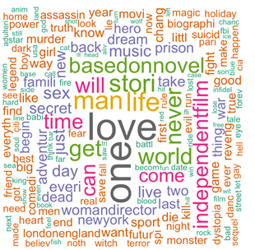
Most Popular Genres: Romantic & Metropolitan
Data Exploration
According to our word cloud, "love" tops the list among all the keywords, indicating the popularity of romantic movies.
Other common words are "man", "life", "time" which are closely related everyday life.
"New York" and "London" are also common words in movies which suggests that many movies set their stages in metropolitan cities.

Slide 7
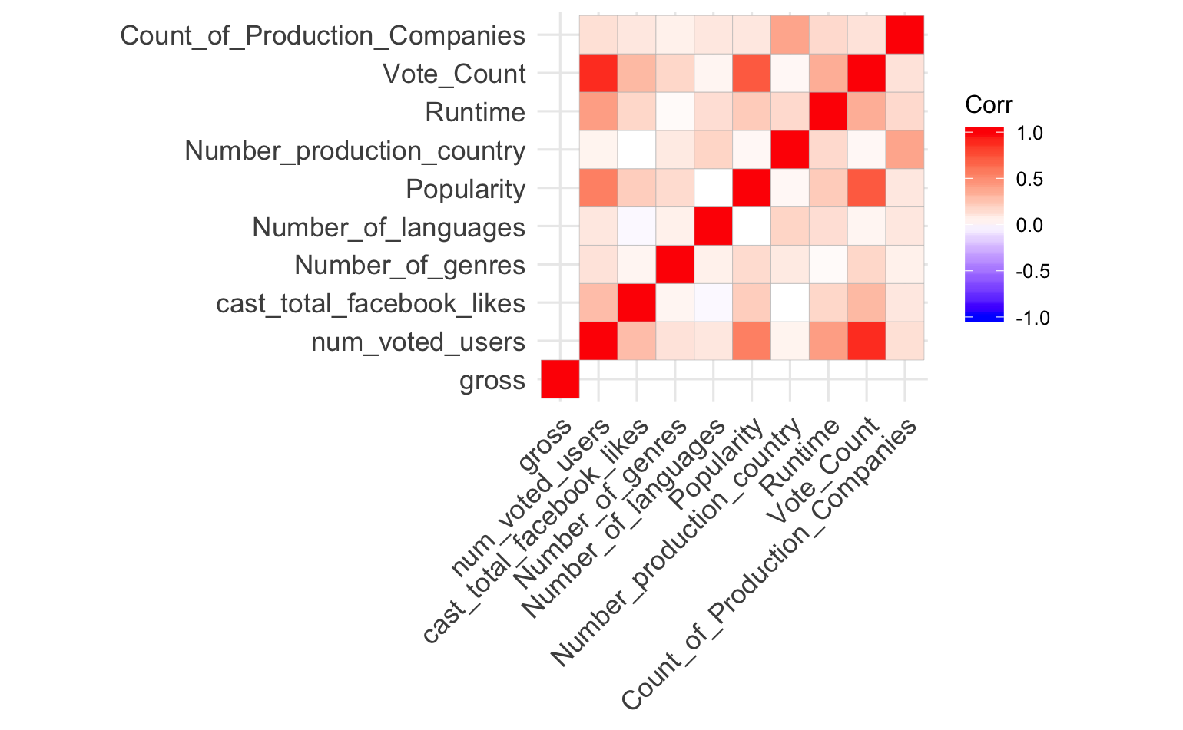
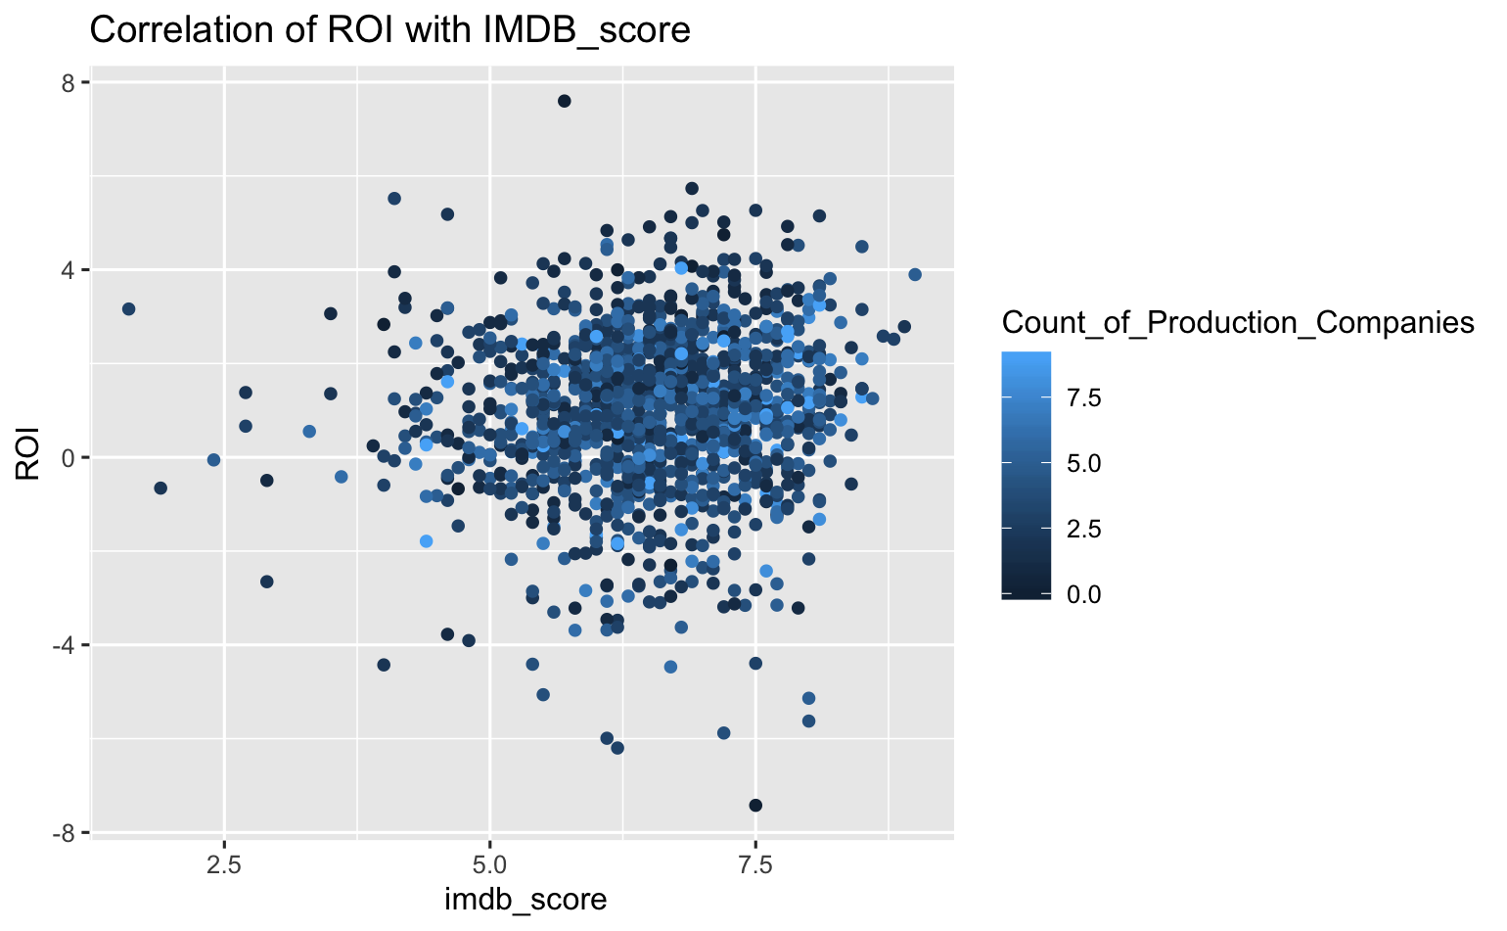
ROI and IMDB score are not necessarily linear
Data Exploration
Month and Revenue do not have significant correlation
Many movies have high IMDB score and high ROI

Slide 8
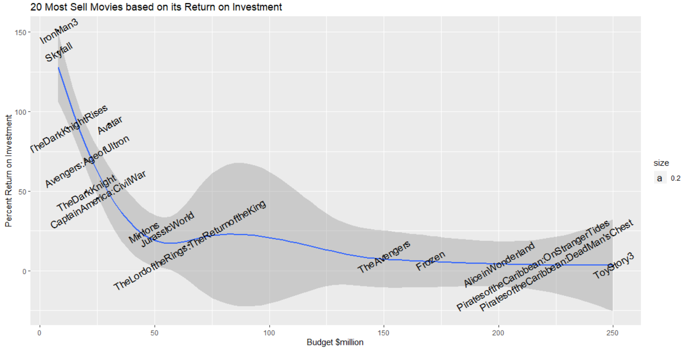
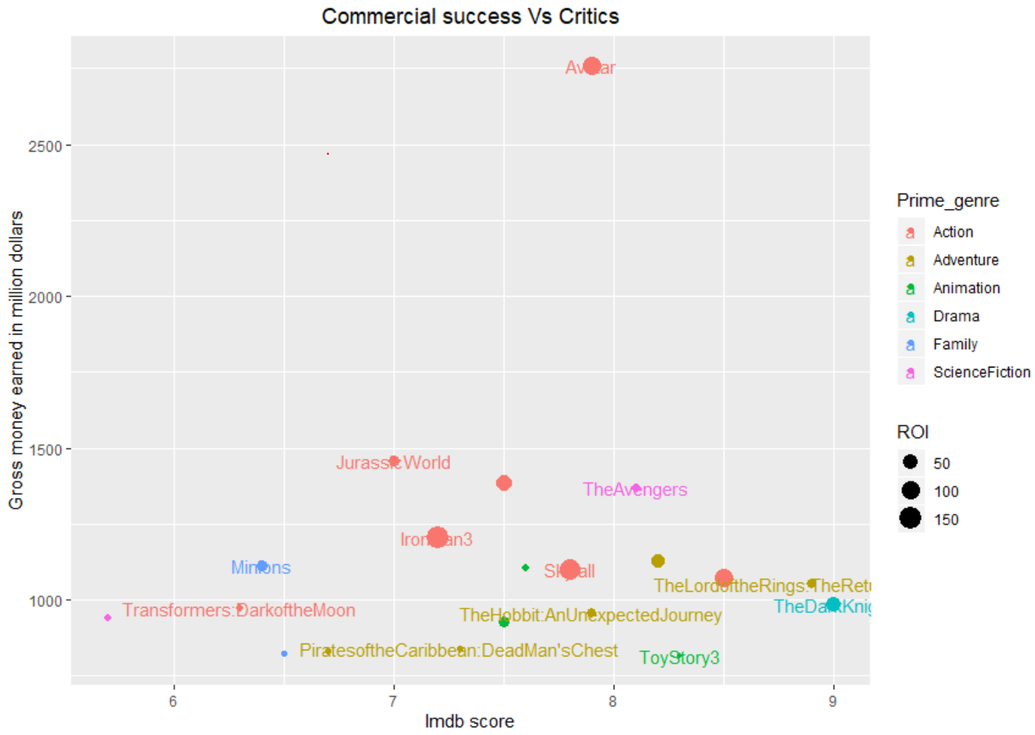
Focus on movies that balance well between ROI and IMDB score
Data Exploration
High budget does not guarantee high ROI
Optimal Movie Selection

Slide 9
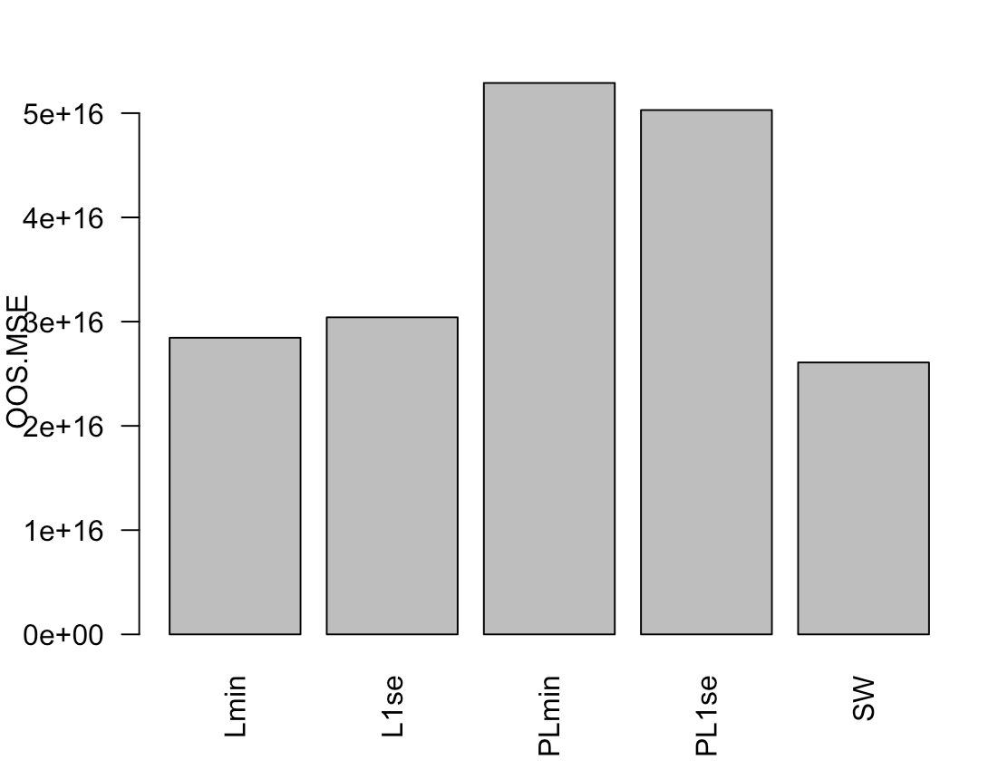
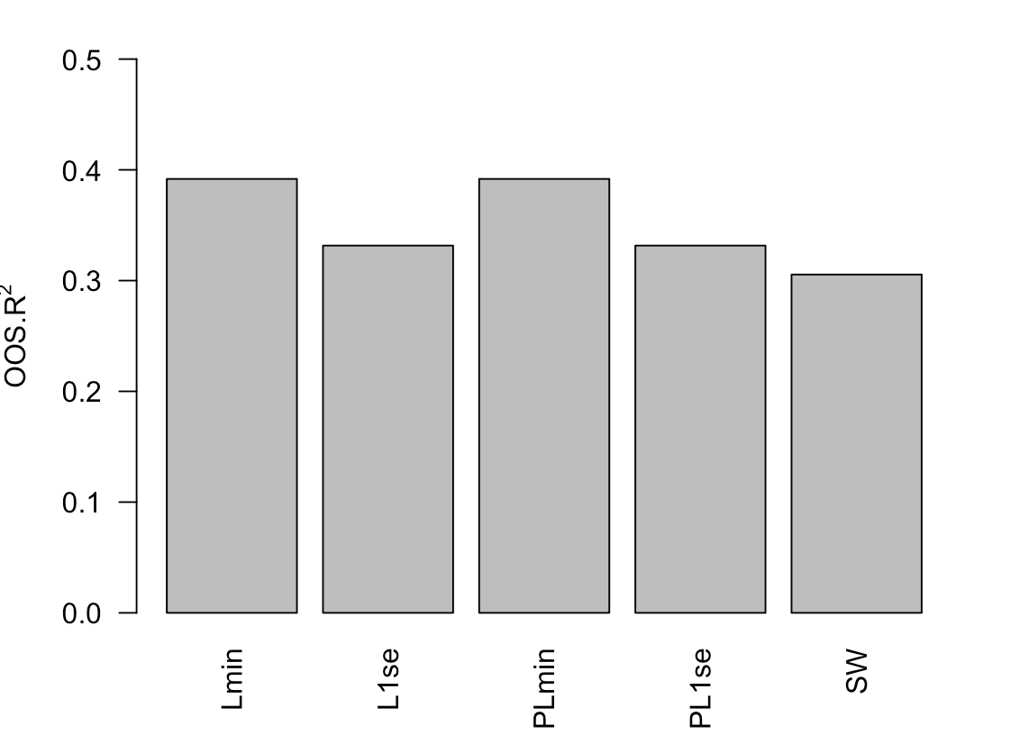
Revenue Prediction
Modelling I
5 models for revenue prediction and evaluated on OOS MSE & R²:
Stepwise regression
Lasso with Lambda.min and Lasso with Lambda.1se
Post Lasso with Lambda.min and Post Lasso with Lambda.1se

Slide 10

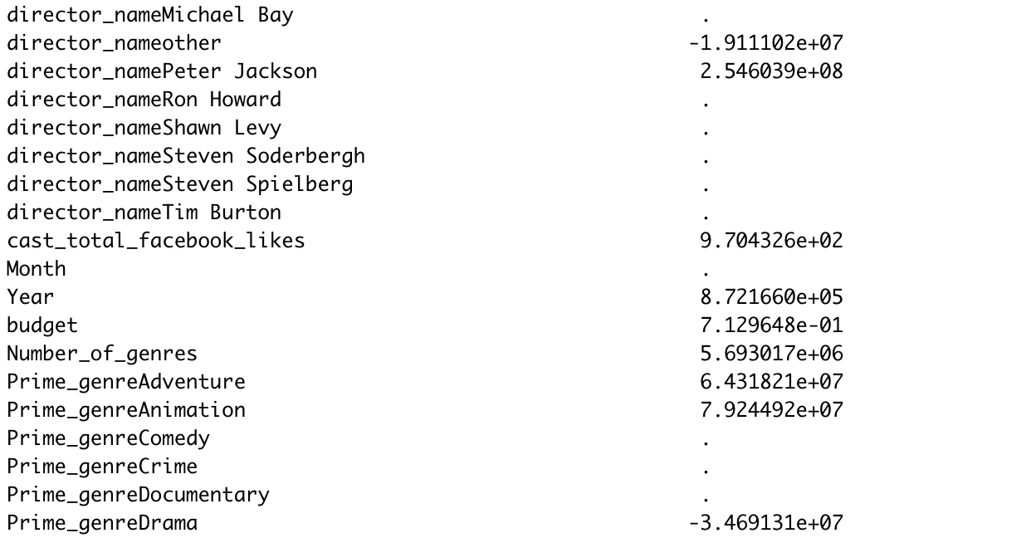

Lasso with Lambda.min
Modelling I
The Lost City
Genre: Drama
Predicted Revenue: 4.39M
Actual Revenue: 6.02M
The Mummy:Tomb of the Dragon Emperor
Genre: Adventure
Predicted Revenue: 381.71M
Actual Revenue: 401.13M

Slide 11
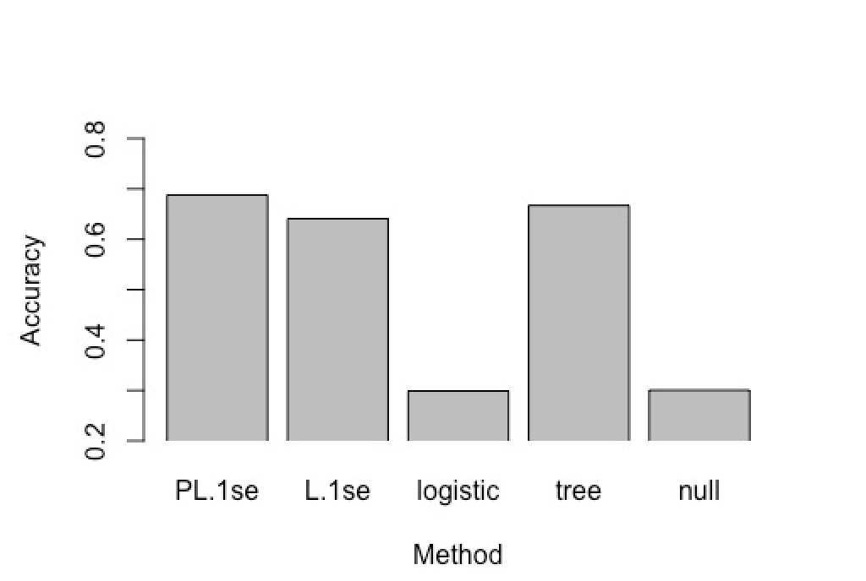
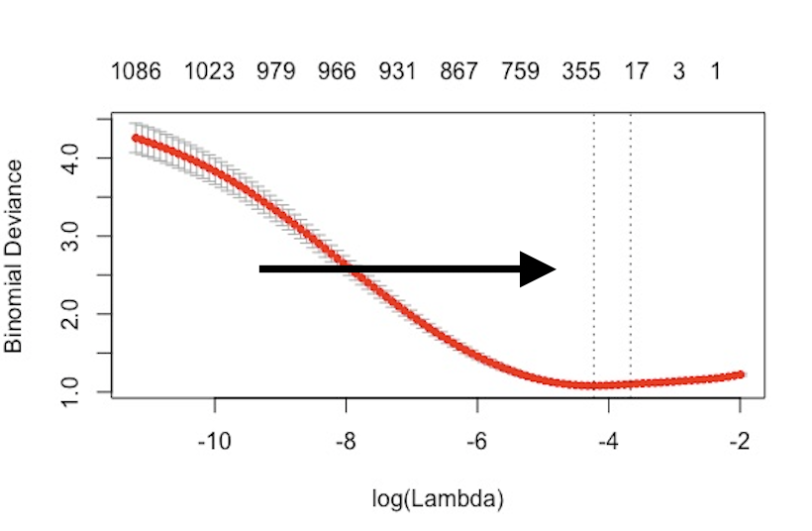
IMDB Rating Prediction
Four Categories
Bad (0 to 5), Acceptable (5 to 6), Good (6 to 7), Excellent (7 to 10)
Multinomial Regression: 54% Accuracy
Classification Tree: 53% Accuracy
Two Categories
0-6(Bad), 6-10 (Good)
Binomial Classification Problem
Start with logistic vs. Classification tree vs. null
Use Lasso and Post-Lasso on our models
Post Lasso variable selections
Modelling II

Slide 12
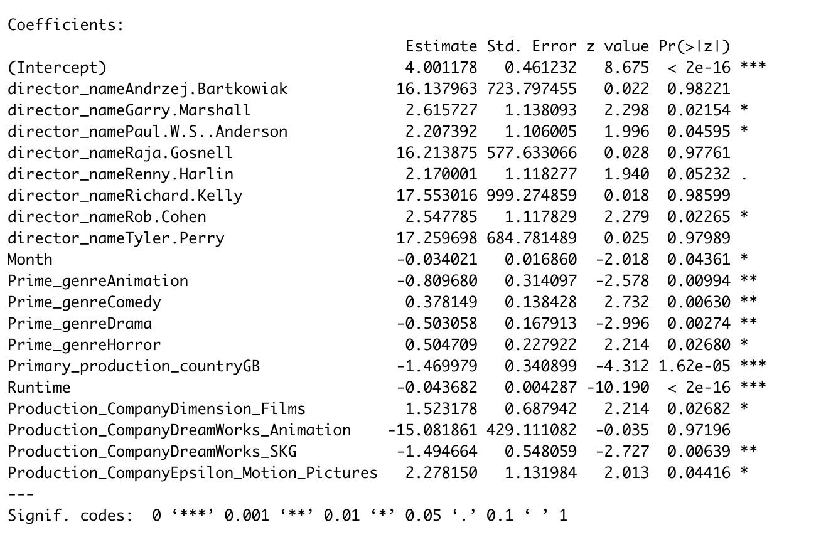
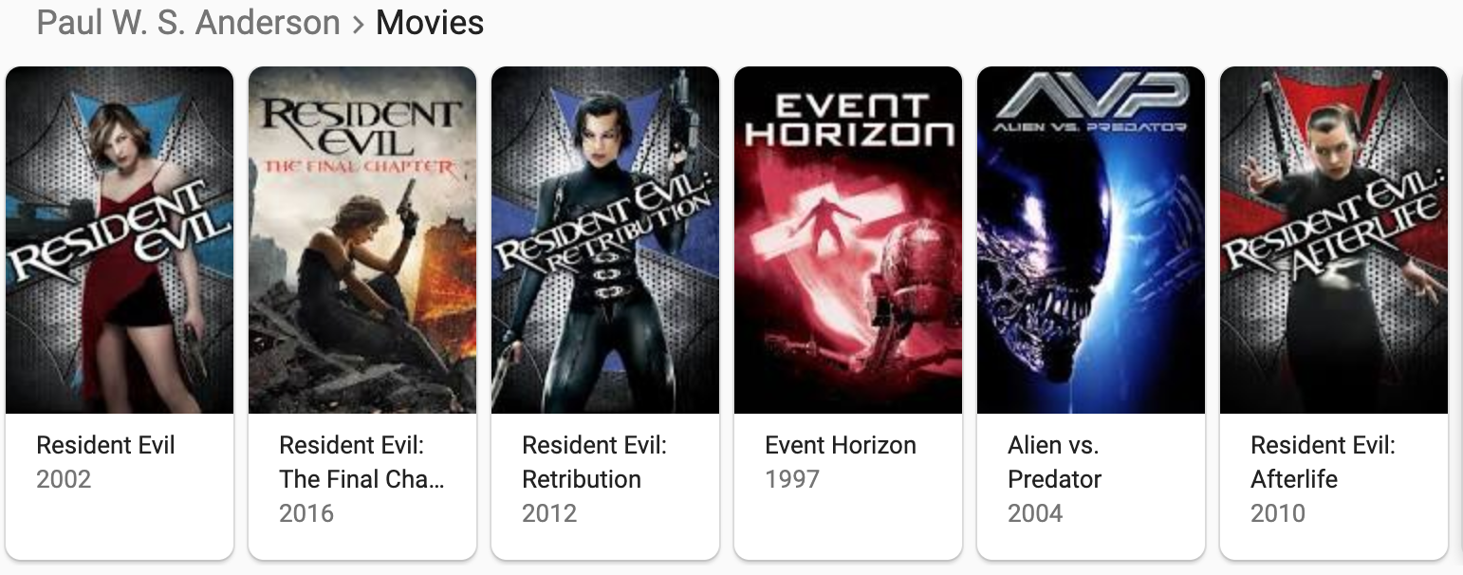
Modelling II

Slide 13
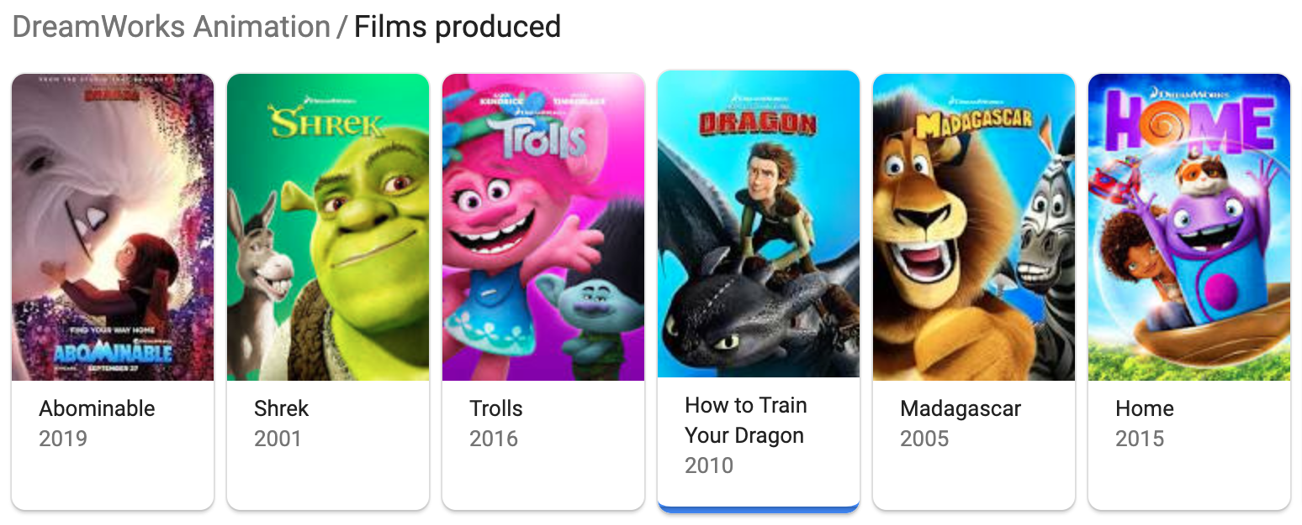
Modelling II

Slide 14
Possible Deployment
Deployment
Investment Decision
Metrics?
Weight?
Strategy: risk-averse? risk-seeking?
Reputation Prediction
Balance between ROI and IMDB score
Other factors?
hhh

